Slide 1

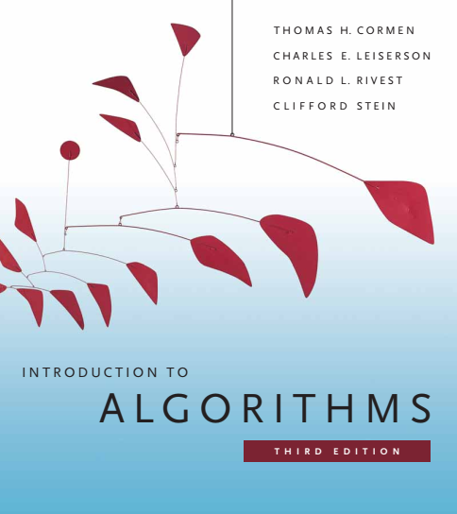
Design and Analysis of Algorithms
Dr. Sajid Iqbal
sajidiqbal.pk@gmail.com
Reference Book
Introduction to Algorithms 3rd Edition By Thomas H. Cormen et. al.
https://mitpress.mit.edu/books/introduction-algorithms-third-edition
COMEDXD

Slide 2
Red Black Trees
Introduction

Slide 3


Introduction
The operations on BST take $O(h)$ time
If tree is large and unbalanced, the time increases and tend to show the liked list complexity
Red-black trees are “balanced” in order to guarantee that basic dynamic-set operations take $O(h)$ time in the worst case
A red-black tree is a BST that stores each node $color$ in addition to $left, right, parent$and $value$.
The additional information i.e. color helps to keep the tree in balanced shape
$$left$$ | $$right$$ | $$parent$$ | $$color$$ | $$value$$
Red-black tree node

Slide 4
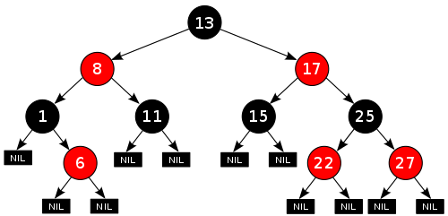

Red-Black (RB) Tree Properties
Every node is either red or black
The root is black
Every leaf (NIL) is black
If a node is red, then both its children are black
For each node, all simple paths from the node to descendant leaves contain the same number of black nodes
Black-height $bh(x)$: Number of black nodes on any simple path from node $x$ to leaf node.
$Bh(T)$ is $bh(root)$

Slide 5
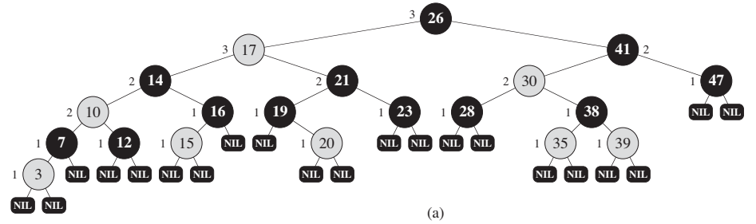
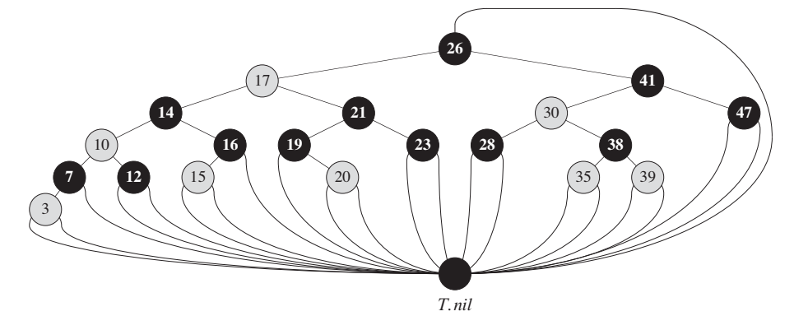

$T.Nil$is a tree node
That is used as sentinel
Instead of having nil node for each Nil, single $T.Nil$sill save space.

Slide 6
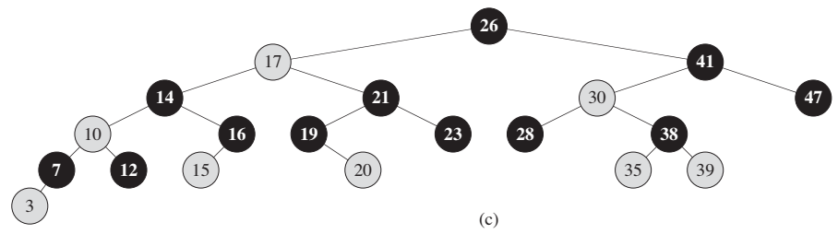


Tree with $T.Nil$node
Tree without $T.Nil$ node

Slide 7

Lemma 13.1
Statement:
A RB tree with $n$ internal nodes has height at most $2log⁡(n+1)$
Proof:
The subtree rooted at any node $x$ contains at least $2^{bh(x)}− 1$ internal nodes
We prove this claim by induction on the height of x
Base Case
If the $height(x)=0, x$is leaf so the number of internal nodes for a tree rooted at $x$ is
$2^{bh\left(x\right)}−1=2^{0}−1=0$
Inductive Step
Let $x$ is an internal node with $bh(x)>0$and has two children
Each child has black height either $bh(x)$ or $bh(x)−1$depending on its color
As height of child of $x$ is one less than its height then
Each child has at least $2^{bh\left(x\right)−1}−1$ internal nodes
Conclusion
Thus subtree rooted at x contains at least ${(2}^{bh\left(x\right)−1}−1)+(2^{bh\left(x\right)−1}−1)+1=2^{bh\left(x\right)}−1$ nodes

Slide 8

Statement:
A RB tree with $n$ internal nodes has height at most $2log⁡(n+1)$
Let h be the height of the tree
According to property 4, “if node is red, both of its children are black”
At least half of the nodes will be black from root to leaf (not including root)
So $bh(root)=h/2$
Number of internal nodes for a tree of height h are given by $2^{bh\left(x\right)}−1$
Hence for height $h/2$ number of internal nodes are $n≥2^{\frac{h}{2}}−1$
$n+1≥2^{\frac{h}{2}}→log\left(n+1\right)=log\left(2^{\frac{h}{2}}\right)$
=$log\left(n+1\right)=\frac{h}{2}log\left(2\right)$
$=log\left(n+1\right)=\frac{h}{2}$
$=2log\left(n+1\right)=h$

Slide 9

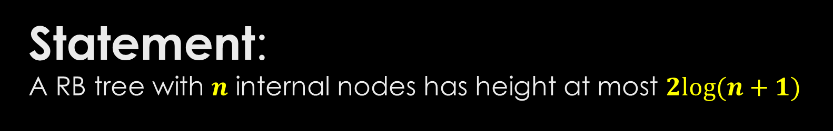
Statement: A RB tree with $n$ internal nodes has height at most $2log⁡(n+1)$
As the height of tree is given by $h=2log⁡(n+1)$
Basic operations like SEARCH, MINIMUM, MAXIMUM, SUCCESSOR, PREDECESSOR will take $O(h)=O(log⁡(n)$time
However the INSERT and DELETE operations are not guaranteed to run in $O(h)$ time.

Slide 10
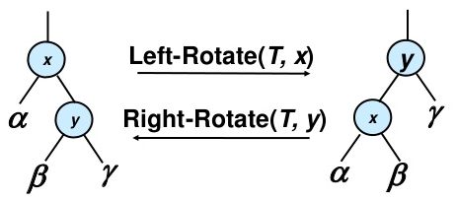

Rotations
INSERT and DELETE operation on RB Tree with n keys can take $O(log⁡n )$ time
The result of these operations may violate the RB Tree properties
It is required to re-arrange the tree
Rotation: this operations re-arranges the BST in order to preserve the RB Tree properties
Rotation can be either left rotation or right rotation
For left rotation of $x$
we assume that its right child $y$ is not $T.NIL$
$X$ may be any node in the tree whose right child is not $NIL$
Left rotation pivots around the link between $x$ and $y$.
It makes $Y$ as new root of subtree
It makes $X$ as $y’s$ left child
$\text{It} \text{makes} left child of y$ as right child as $x$

Slide 11
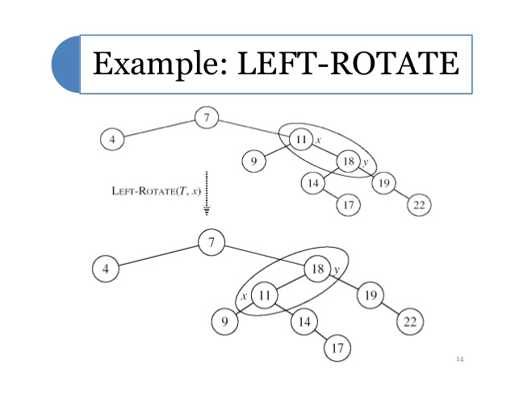
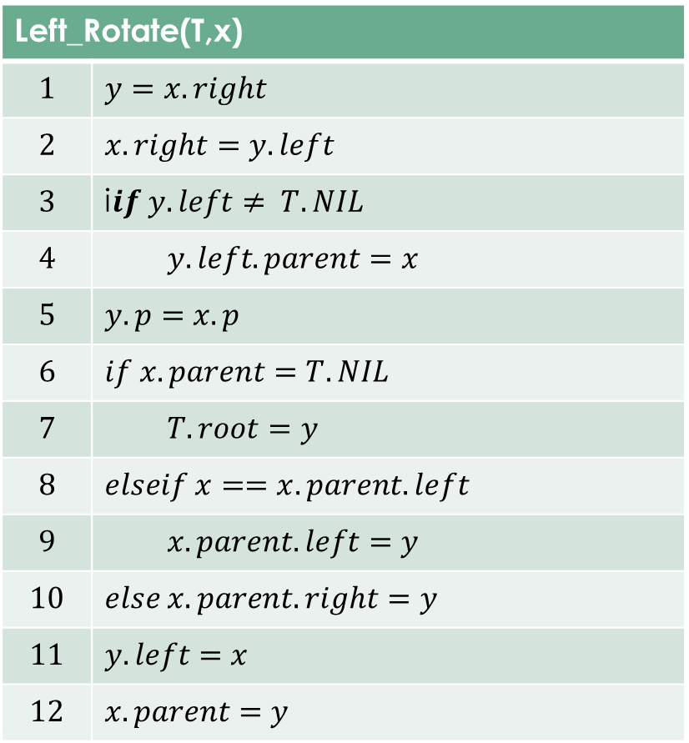
Left Rotation
Left_Rotate(T,x)
$$1$$ | $$y=x.right$$
$$2$$ | $$x.right=y.left$$
$$3$$ | i$if y.left≠ T.NIL$
$$4$$ | $$y.left.parent=x$$
$$5$$ | $$y.p=x.p$$
$$6$$ | $$if x.parent=T.NIL$$
$$7$$ | $$T.root=y$$
$$8$$ | $$elseif x==x.parent.left$$
$$9$$ | $$x.parent.left=y$$
$$10$$ | $$else x.parent.right=y$$
$$11$$ | $$y.left=x$$
$$12$$ | $$x.parent=y$$

Slide 12
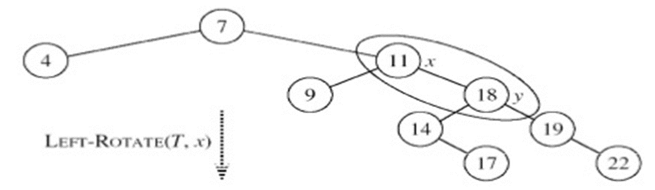
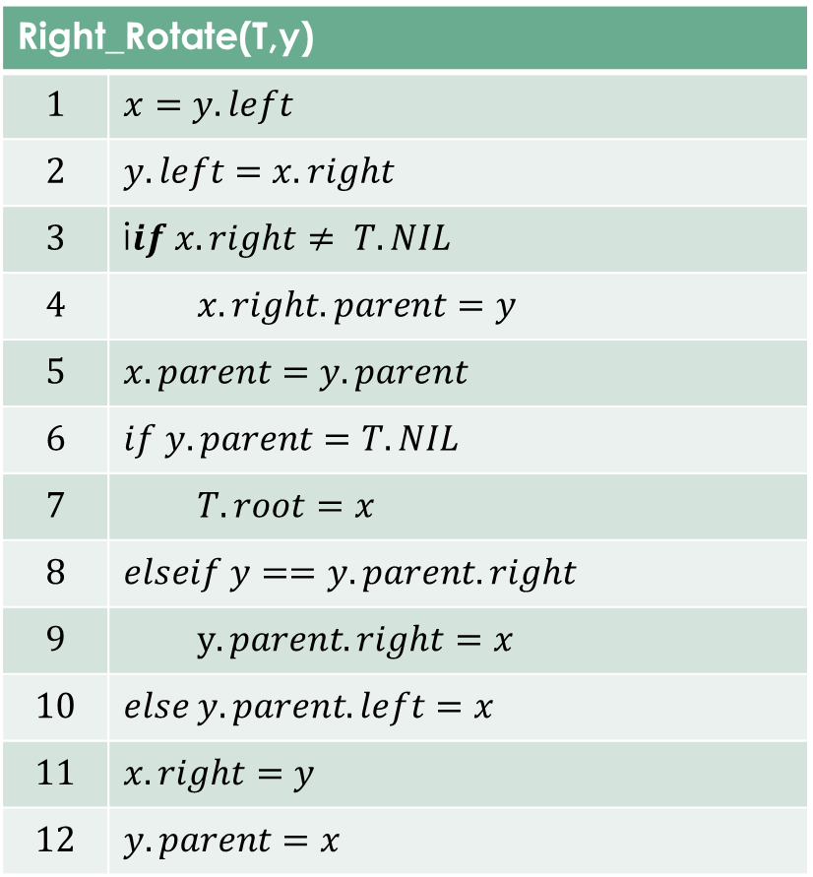
Right Rotation
Right_Rotate(T,y)
$$1$$ | $$x=y.left$$
$$2$$ | $$y.left=x.right$$
$$3$$ | i$if x.right≠ T.NIL$
$$4$$ | $$x.right.parent=y$$
$$5$$ | $$x.parent=y.parent$$
$$6$$ | $$if y.parent=T.NIL$$
$$7$$ | $$T.root=x$$
$$8$$ | $$elseif y==y.parent.right$$
$$9$$ | $$y.parent.right=x$$
$$10$$ | $$else y.parent.left=x$$
$$11$$ | $$x.right=y$$
$$12$$ | $$y.parent=x$$
Right Rotate

Slide 14



Thanks for watching
Dr. Sajid Iqbal
Assistant Professor
Department of Computer Science
Bahauddin Zakariya University, Multan
sajidiqbal.pk@gmail.com
https://github.com/sajjo79/Design_and_Analysis_of_Algorithms
COMEDXD
Allah Hafiz

Slide 15
https://walkccc.github.io/CLRS/Chap13/13.1/

